Slide 1
Lecture 38

Slide 2
Carnot Engine

Slide 3
A
D
B
C

Slide 4
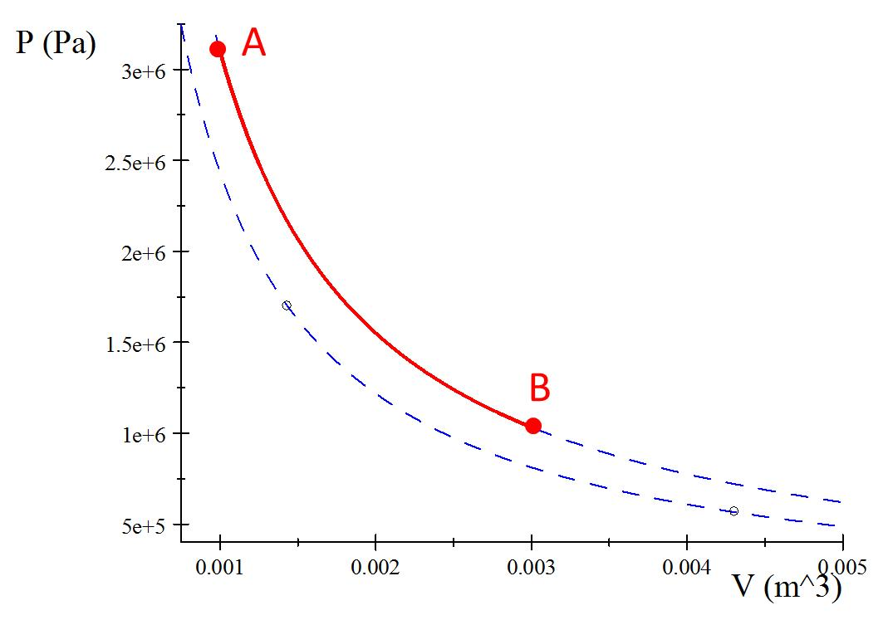

Process A to B
Q_{h}

Slide 5
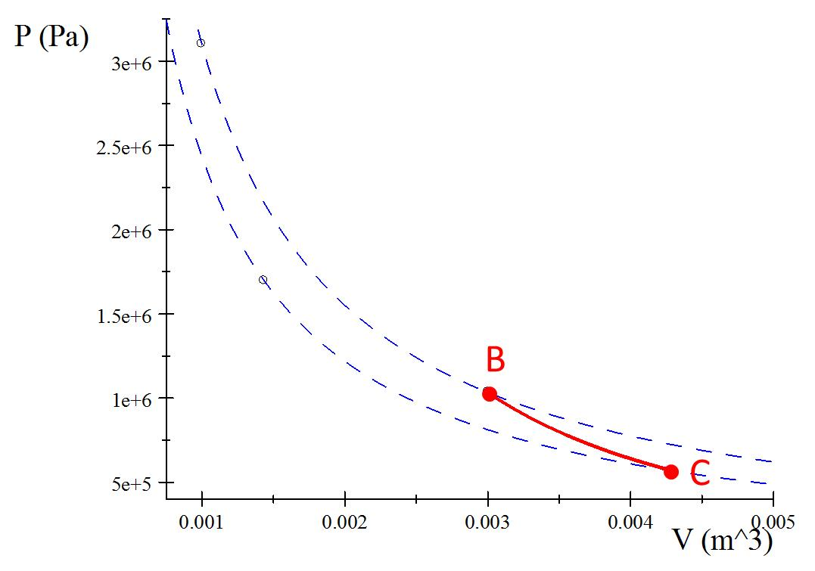
Process B to C
Insulator

Slide 6
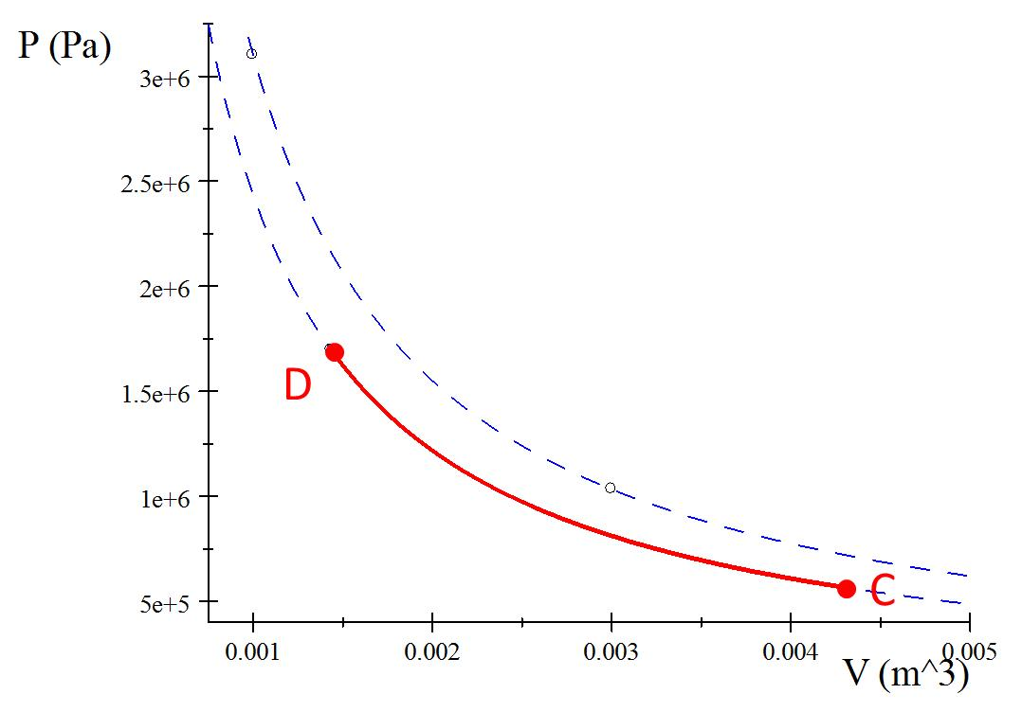
Process C to D
Q_{c}

Slide 7
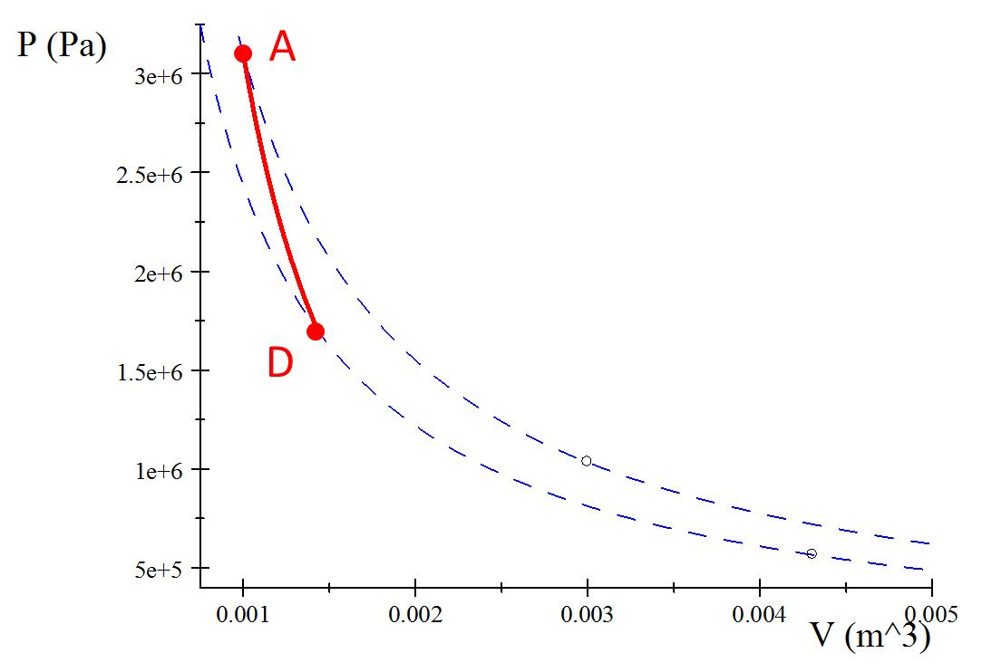
Process D to A
Insulator

Slide 8
A
B
C
D

Slide 9
Question
What kind of path is shown in the PV diagram?
Isochoric
Isobaric
Isothermal
Adiabatic
A
B

Slide 10
Process A’B
A
B
Q_{h}

Slide 11
A
B

Slide 12
Question
What kind of path is shown in the PV diagram?
Isochoric
Isobaric
Isothermal
Adiabatic
B
C

Slide 13
Process B’C
B
C
Insulator

Slide 14
B
C

Slide 15
Question
What kind of path is shown in the PV diagram?
Isochoric
Isobaric
Isothermal
Adiabatic
D
C

Slide 16
Process C’D
D
C
Q_{c}

Slide 17
D
C

Slide 18
Question
What kind of path is shown in the PV diagram?
Isochoric
Isobaric
Isothermal
Adiabatic
A
D

Slide 19
Process D’A
A
D
Insulator

Slide 20
A
D

Slide 21





Identify the type of process
Write out the special equations for that process
Symbolically solve for ΔE, Q, W, P, V, and T
Identify your contribution to Q_{h} and Q_{c}
Fill in with numbers
$$V_{A}=0.001m^{3}$$
$$V_{C}=0.015m^{3}$$
$T_{A}=1023$K
$$T_{C}=293\text{K}$$
$n=$1mol

Slide 22
A
B
D
C

Slide 23
Question
Which process is part of Q_{h}?
AB
BC
CD
DA
A
B
D
C

Slide 24
A
B
Q_{h}
Q_{c}
C
D

Slide 25
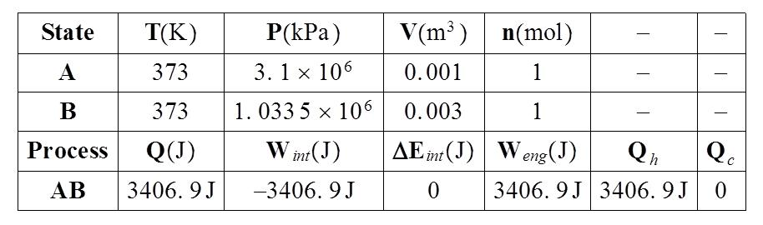

Slide 26


Identify the type of process
Write out the special equations for that process
Symbolically solve for ΔE, Q, W, P, V, and T
Identify your contribution to Q_{h} and Q_{c}
Fill in with numbers
$$V_{A}=0.001m^{3}$$
$$V_{C}=0.00431m^{3}$$
$T_{A}=373$K
$$T_{C}=293\text{K}$$
$n=$1mol

Slide 27
A
D
B
C

Slide 28
A
Q_{h}
D
B
Q_{c}
C

Slide 29
Question
A Carnot cycle operating between Th=1023K and Tc=273K has an efficiency of 73%.
And Otto cycle operating between Th=1023K and Tc=273K has an efficiency of 56%
Is the Otto cycle possible?
Yes
No
Maybe

Slide 30
END

Slide 31
A
B
C
D

Slide 32
A
B

Slide 33
B
C

Slide 34
D
C

Slide 35
A
D

